Slide 1
Gesture recognition

Slide 2
Gesture recognition
Gesture recognition is a type of perceptual computing user interface that allows computers to capture and interpret human gestures as commands.
This has proven to be useful in enhancing user experience

Slide 3
Applications
Integrating the gestural channel in Human-Computer interaction
virtual environment control
sign language translation
robot remote control
ASL recognition

Slide 4
Related Work
Extract spacio-temporal features and build Hidden Markov Models
Using techniques like Support Vector Machines, Artificial Neural Networks, Fuzzy c-means clustering, etc. where feature engineering plays a crucial role in prediction accuracy.
Recent researches in CV suggest that deep learning gives the best classification accuracy for gesture recognition.

Slide 5
Challenges in detecting hand
If we contour the hand by the RGB value (color of the skin) then the issue is that our face and background might get filtered in too.
Wearing a different colored glove may solve the issue with contour but it degrades the user experience
Challenges with variable lighting in case of contouring with RGB values
Differences in skin tone range of the user
Subtracting background might not be effective since it would add in noise.

Slide 6
An Iterative Approach
1) The Region Of Interest is kept static
The region where the hand should appear is static and predefined
2) The Region Of Interest is dynamically determined
The region where the hand should appear is not predefined detected on the fly in the runtime.

Slide 7
Static Processing
OpenCV continuously gets input frames from the system camera.
The input frame is transformed from RGB to YCbCr color space.
From the input frame, we crop out the ROI and convert it into a binary image and apply Gaussian filter.
The first ROI frame is saved as a reference for the background and in the next 25 frames, we accumulate the weights and update the background.
Once the background is fixed, perform morphological transformations like dilation, erosion and median filter to sieve the background noise and preserve structural integrity.
Threshold the image to get the foreground. The maximum contour area gives the segmented hand which could be sent to the model for gesture prediction.

Slide 8
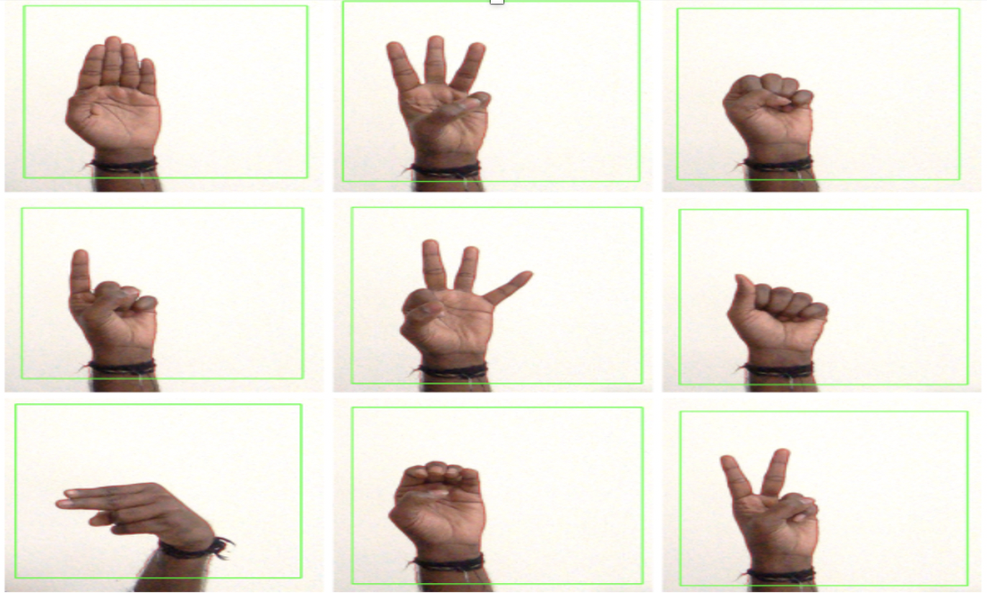
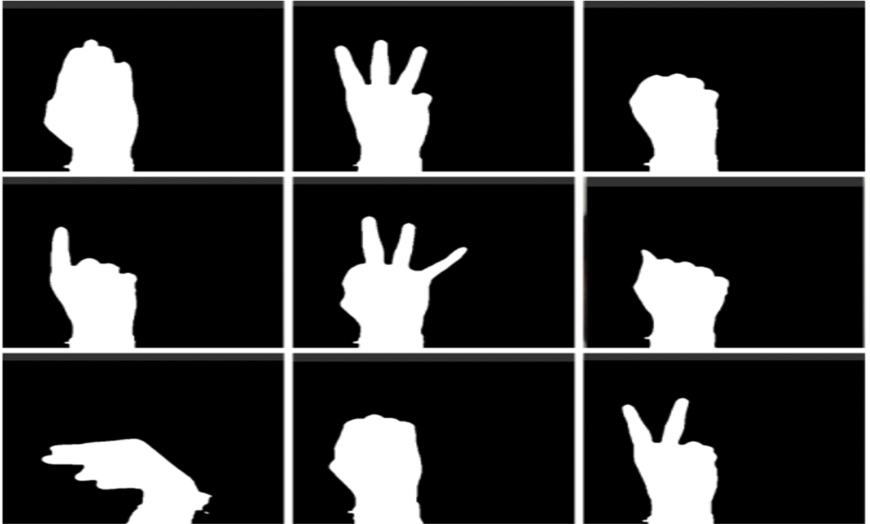

Slide 9
Challenges - static
We expect “only the hand” to be present in the ROI

Slide 10
Dynamic Processing
RGB image frame is converted to YCbCr color space.
Using facial landmark detection, color of the skin pixels are determined
Skin colored pixels are extracted with a threshold.
Binarize the resultant image and apply the same set of morphological operations as described in the previous method.
Use convex hull algorithm (gives the smallest convex polygon that contains all the points within it) to identify the smallest convex polygon that surrounds the hand region thereby isolating the hand from the rest of the frame.

Slide 11
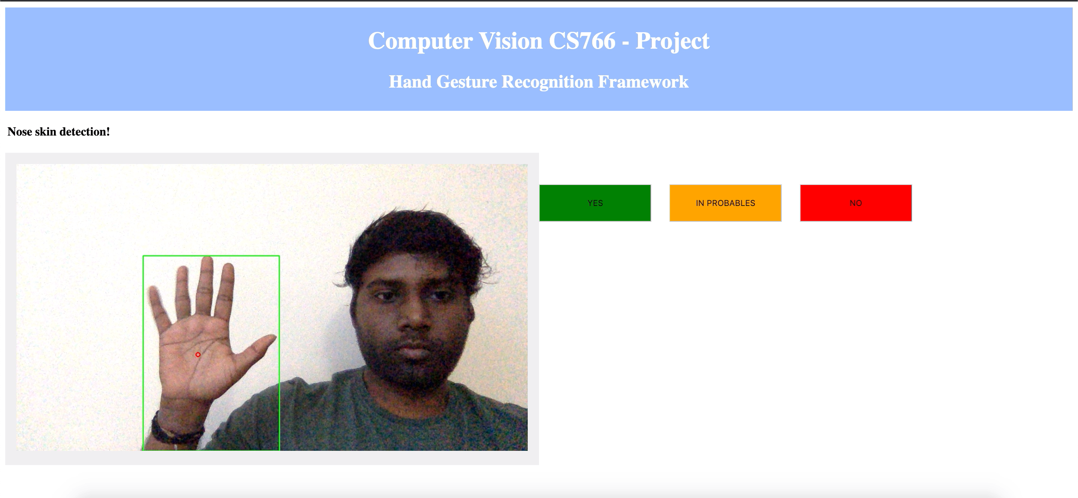

Slide 12
https://youtu.be/pL4nyw4-g2k

Slide 13
CNN Model
The convolutional neural network (CNN) is a class of deep learning neural networks.
CNNs are most commonly used to analyze visual imagery and are frequently working behind the scenes in image classification.
Before CNN, people spent a lot of time on feature selection
When compared with these handcrafted features, CNN perform as well or even better in terms of accuracy

Slide 14
Static Model Architecture

Slide 15
Dataset
Training data set contains 87,000 images which are 200x200 pixels. There are 29 classes, of which 26 are for the letters A-Z and 3 classes for Space, Delete and nothing.
https://www.kaggle.com/grassknoted/asl-alphabet
The test data set contains a mere 29 images per class.
We took more images personally to add to this dataset.
The first model is built from scratch. It is trained for 5 epochs. Using GPU the training time is roughly around 180-200s for each of the epoch
Final training accuracy of the model is 0.9647 and the final validation accuracy is 0.8948. However, testing with real world images lead to an accuracy of 41.15% only.
Once images were preprocessed the accuracy improved to 51.23%.

Slide 16
Problems
It took around 20 mins for 5 epochs with a GPU.
It is hard to find resources like GPU as well
we needed to retrain after every minor change in the code.

Slide 17
Dynamic Model
To resolve above issues we used the concept of transfer learning
This mitigated the tedious job of building CNN from scratch and training them besides providing better accuracy.
Here we have used MobileNet CNN Model for transfer learning which is trained with 1.2 million images with 1000 classes.
The model combines four Mobilenets that are trained at 5000, 10000, 15000 and 20000 learning iterations with a learning rate of 0.001.
We use ensemble Learning to combine decisions from multiple machine learning models (such as classifiers)

Slide 18
Model – part 1

Slide 19
Model – part2

Slide 20
Result Demo
https://www.youtube.com/embed/SxZi8f-rl9Q

Slide 21
Results
Gesture classified correctly and feedback YES is given to the model to update the prediction score.
Gesture classified is in the probablities list and feedback IN PROBABLES has been sent to the model. Later when the same gesture is given, our system was able to classify it in the expected way.
Some letters for which our gestures classified incorrectly, a feedback NO is delivered.

Slide 22
Challenges
Unrecognizable skin color.
Cluttered background.

Slide 23
Future work
Gestures that require spatio-temporal features for classification could be determined using depth sensors.
For cases where the background color is close to the skin color of ROI, the hand segmentation is not so effective. Techniques to overcome this problem would significantly broaden the application of our system.
Memory based learning algorithms like RNN, LSTM could be used to extend the range of supportable gestures by also considering those which involve object movement between frames into account.

